Slide 1
Units of Energy

Slide 2
By the end of this lesson, you should be able to do the following:
Define the basic unit of energy.
Convert between different measurements of energy.

Slide 3
Energy is measured in joules:
(J)
We say that the joule is the unit of energy.
If an object has many joules of energy, it has lots of energy.

Slide 4
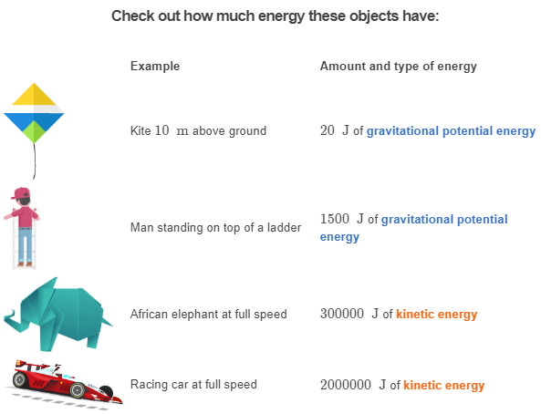

Slide 5
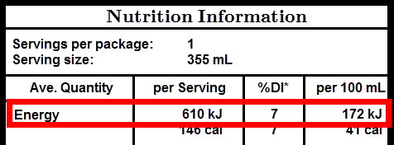
A kilojoule is the same as 1000J.
It has the symbol kJ.
You may have seen numbers given in kJ on food packaging. They are a convenient way of measuring the amount of chemical potential energy stored in an item of food.

Slide 6
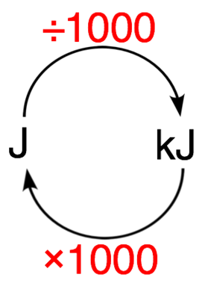
To convert a number of joules to kilojoules, you divide the number by 1000.
To convert a number of kilojoules back into joules, you multiply by 1000.

Slide 7
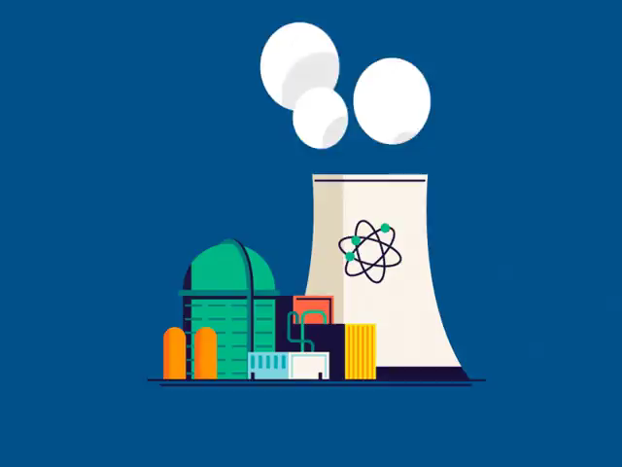
A megajoule is 1000kJ or 1000000J (one million joules).
Megajoules are used to measure things that use or put out massive amounts of energy, like the amount of energy put out by a power station every second.

Slide 8
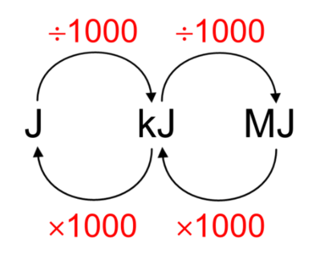
To convert a number of joules to megajoules, you divide the number by 1000000.
To convert a number of megajoules into joules, you multiply by 1000000.
This is of course the same as multiplying or dividing by 1000 twice.

